Slide 1
FacultyTenureAnalysis
Linli Zhou

Slide 2
Research Questions
How has the proportion of tenure-line (TL) and non-tenure-line (NTL) faculty changed over time?
How has the proportion of TL faculty in certain rank, racial, or sex groups changed over time?
How has the proportion of TL and NTL faculty changed over time for different departments?

Slide 3
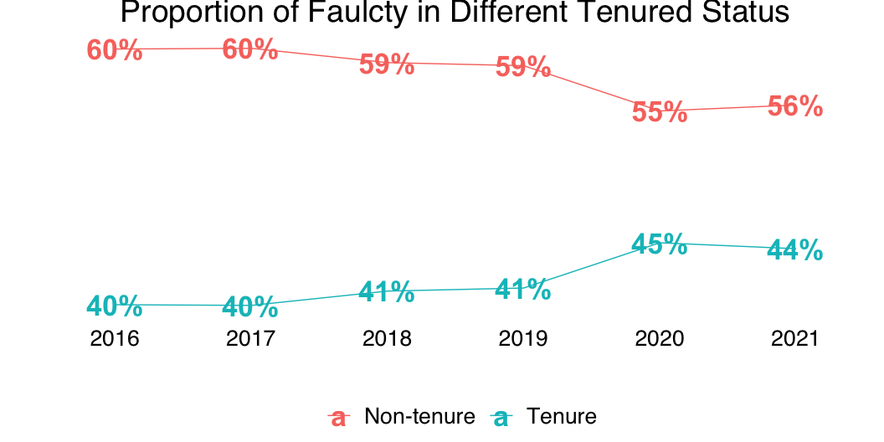
Historical Trends
Notes:
Tenured percentage has been increased since 2016 from 40% to 44% in 2021, with 2020 being the highest 45%.
Non-Tenure-line Faculty percentage has been decreased from 60% to 56%, with 2020 being the lowest 55%.
There are still 12% less Tenure-line Faculty than non tenured.

Slide 4
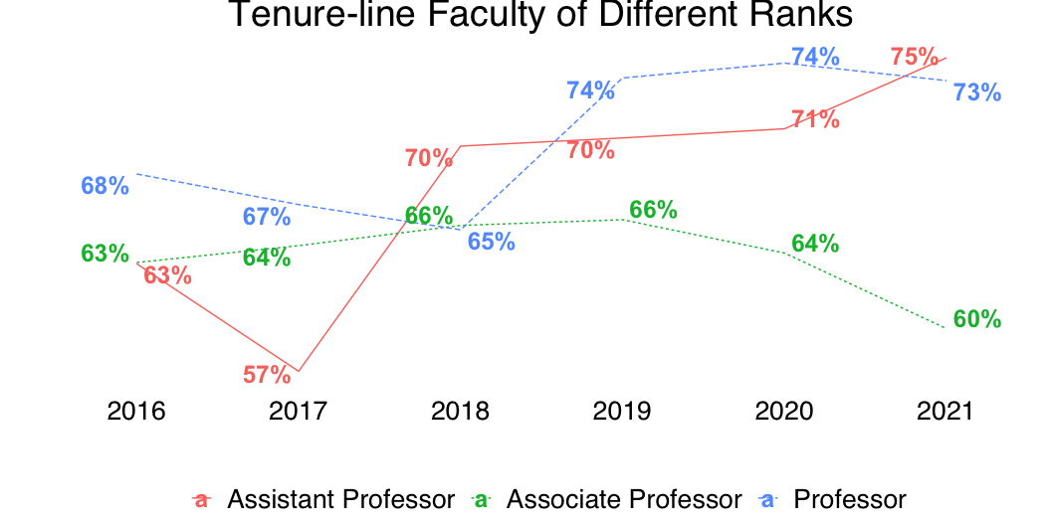
Historical Trends Breakdown: Faculty Rank
Notes:
Assistant professor tenure-line proportion dropped from 63% in 2016 to 57% in 2017 and became the lowest across professor ranks. However, the proportion but has been increasing ever since and reached 75% in 2021.
Professor experienced a slight drop from 68% in 2016 to 65% in 2018, but has increased ever since and reached 73% in 2021.
Associate professor has slight increase from 63% in 2016 to 66% in 2019, but dropped to 60% in 2021.

Slide 5
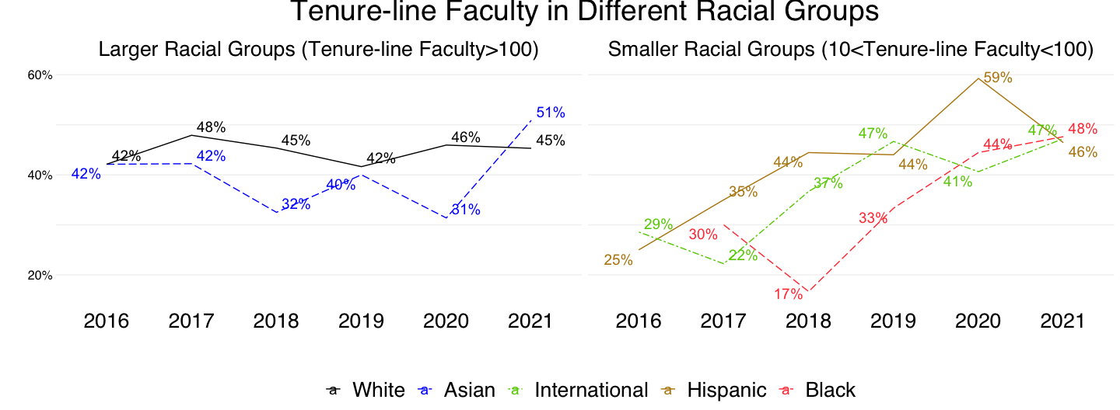
Historical Trends Breakdown: Race
Notes:
White faculties have the most stable tenured proportion – within the 42-48% range.
Asian faculties experienced two dropped in 2018 and 2020 and only has 31-32% tenured proportion. The tenured proportion increased from 31% to 51% in 2021.
Smaller racial groups have below 30% tenured proportions before 2018. However, their tenured proportion has been increasing since 2018 and reached 46-48% in 2021.
Omitted details: - 2017 and 2018 are years that most groups experienced drops except Hispanic faculties. International faculties dropped 7% in 2017 and Black faculties dropped 13% in 2018. - Hispanic faculties’ tenured proportion has been increasing from 25% in 2016 to 59% in 2020. However, it dropped to 46% and become close to other groups.
International faculties have the lowest tenured proportion of 20% in 2016, but the proportion jumped to 50% in 2018 and 2021.
Hispanic faculties have increased tenured proportion from 33% in 2016 to 59% in 2020, and 55% in 2021, both are the highest among all racial groups in those two years.
Black faculties’ tenured proportion dropped from 50% in 2017 to 20% in 2018, but has been increasing by 7% each year to 44% in 2020 and kept stable at 45% in 2021.

Slide 6
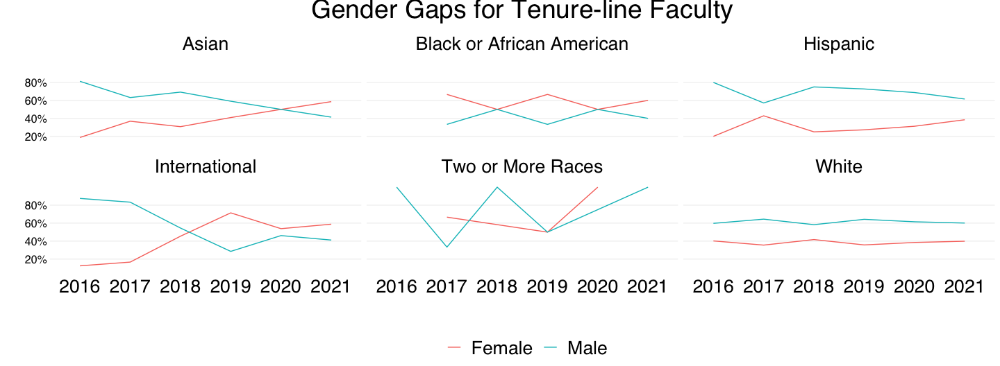
Historical Trends Breakdown: Legal Sex in Different Race
Notes:
Hispanic and White faculties have a consistent gender gap with male faculties have higher tenured proportion than female faculties.

Slide 7
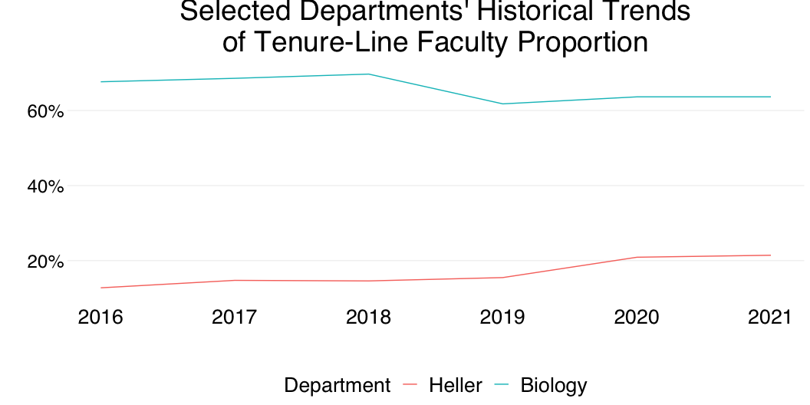
Departmental Tenure Status

Slide 8
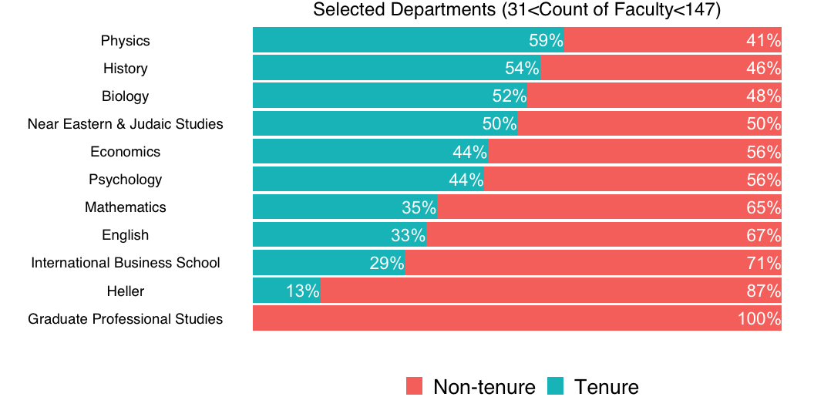

Slide 9
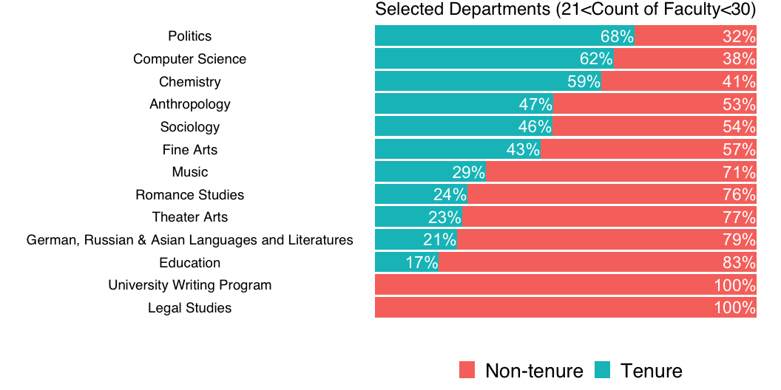

Slide 10
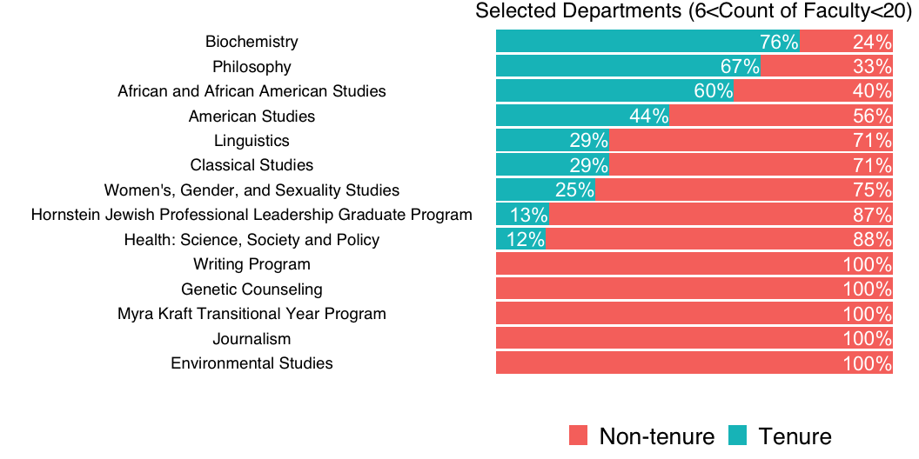

Slide 11
